Slide 1
Benchmarking GNNs, DL, and ML for Neurological Disorder Classification
-A Graph-Based Approach to Functional Brain Connectomes
Notes:
Good [morning/afternoon], everyone. My name is [Your Name], and today I will present our work on benchmarking graph neural networks, deep learning, and machine learning approaches for neurological disorder classification, specifically focusing on brain connectomes.

Slide 2
Name & ID
Name | ID
22-46862-1 | Rakesh Karmaker
21-44414-1 | Rukaiya Islam
21-44425-1 | Khandkar Md.Antik Mahmud

Slide 3
Table of contents
01
02
03
04
05
06
Table Of Contents
Problem Background
Motivation
Objective
Methodology
Results
07
08
09
Main Contribution
Conclusion
Reference & Q/A

Slide 4
02
Problem Background

Slide 5
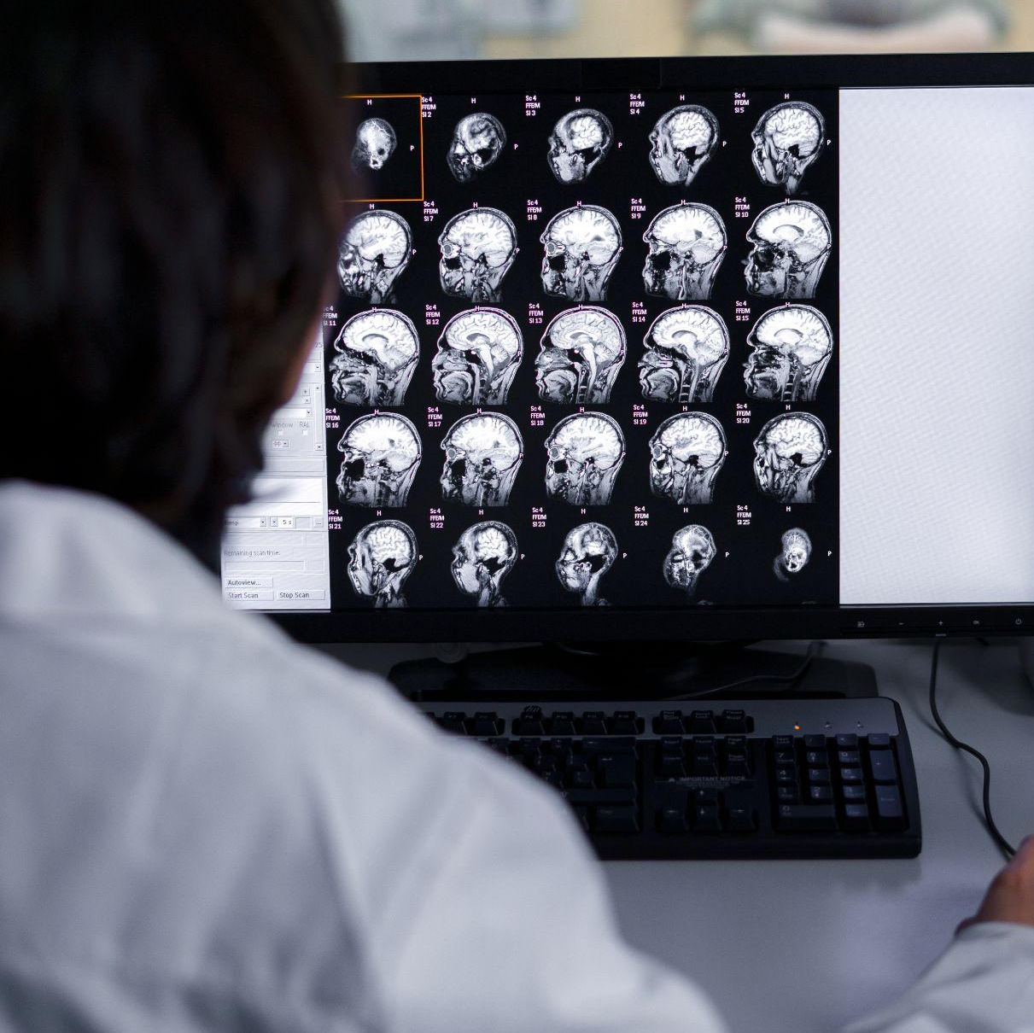
Concerns!
"Over 55 million people worldwide live with dementia, a number expected to nearly double every 20 years.“
It is Estimated to reach 78 million by 2030 and 139 million by 2050, according to the World Health Organization (WHO)
Notes:
Our motivation is rooted in a pressing health crisis: over 55 million people worldwide live with dementia, and this number is expected to double every 20 years.

Slide 6
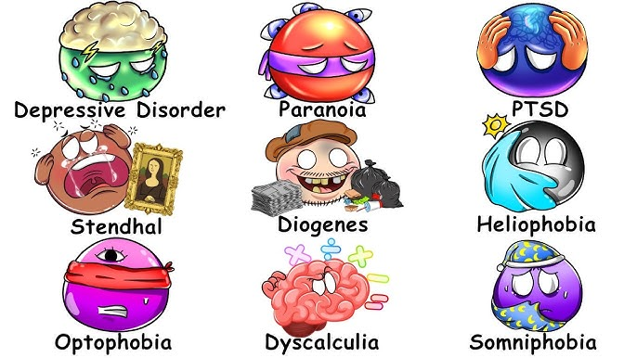
Types of Brain Diseases
1. Neurodegenerative
Alzheimer’s
Parkinson’s
Multiple Sclerosis
2. Vascular Diseases
Stroke
3. Infections
Meningitis
Encephalitis
4. Epilepsy
5. Brain Tumors
Notes:
Neurodegenerative Diseases 🧠
Alzheimer’s: Memory & cognition decline
Parkinson’s: Movement & coordination disorder
Multiple Sclerosis: Immune system attacks nerves
Vascular Diseases
Stroke: Brain cell death due to blocked or burst blood vessel
Infections 🦠
Meningitis: Infection of brain membranes
Encephalitis: Inflammation of brain tissue
Epilepsy ⚡
Seizures from abnormal brain electrical activity
Brain Tumors 🎯
Abnormal growths affecting brain function
Head Injuries 💥
Concussions & traumatic brain injuries

Slide 7
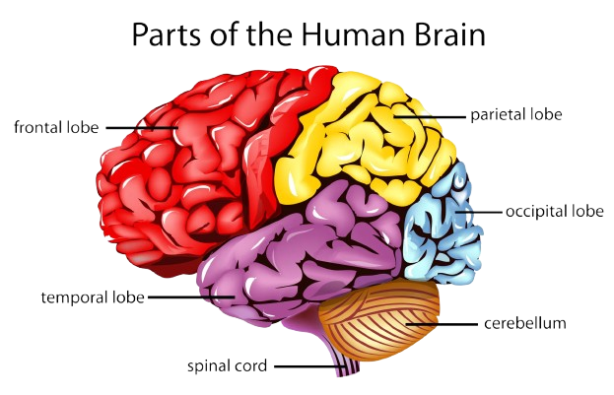
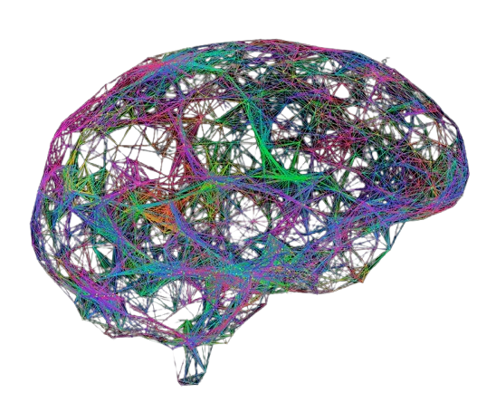
The Brain as a Network
The brain is a complex system of interconnected regions.
Functional Connectomes model this system as a graph:
Nodes: Brain Regions (ROIs from an atlas like AAL).
Edges: Functional Connectivity (e.g., correlation of fMRI signals).
Brain as Network
Notes:
With AI & GNNs lies the opportunity!
the brain is like a giant network, where each region is a node and the connections between them are edges. By modeling the brain as a graph, we can use AI to capture subtle communication breakdowns that happen long before symptoms appear.”

Slide 8
03
Motivation

Slide 9

Early and accurate diagnosis is critical. Can AI help
?
Notes:
Neurological disorders, such as dementia, affect millions worldwide. Early diagnosis is critical, yet challenging. Traditional diagnostic methods are often late or subjective. Our goal is to leverage AI to detect early subtle changes in the brain’s functional networks. Can it

Slide 10
Motivation
Classical ML flattens connectivity → loses topological info.
CNN/MLP struggle with non-Euclidean graph structures.
GNNs capture node features + connectivity simultaneously.
Need: Benchmark ML, DL, and GNNs on the same dataset
Notes:
Existing methods have limitations. Classical machine learning ignores the brain’s network topology. Deep learning struggles with graph-structured data. Graph neural networks, however, can natively handle graphs, making them ideal for brain connectomes. Our study benchmarks these paradigms under a standardized setup.

Slide 11
04
Objective

Slide 12
Objective
1. Benchmarking ML, DL, GNN on OASIS brain MRI graphs.
Systematically implement, train, and evaluate representative models from three families:
2. Compare performance: Accuracy, F1, Precision, Recall, Precision, Visualize Confusion Matrix.
3. Hybrid Model Exploration
Propose and evaluate a hybrid pipeline using GNN-derived embeddings as input for classical anomaly detectors.
GNN embeddings → classical ML
3. Analyze robustness to noise and incomplete data
Test model performance under realistic challenges: noise, sensor drop-out (simulated), and cross-dataset generalization.
Notes:
Our objectives are threefold: first, to benchmark ML, DL, and GNN models fairly; second, to explore hybrid models that use GNN embeddings with classical ML; and third, to assess the robustness of these models under practical conditions like noise or missing data

Slide 13
05
Methodology

Slide 14
Methodology – Data & Graph Construction
Dataset:
OASIS structural MRI + clinical features
Graph nodes:
116 brain regions (AAL atlas)
Edges:
Structural connectivity template (thresholded Euclidean distance)
Node features:
MRI regional + clinical features
Labels:
NonDemented (0) / Demented (1)
Notes:
We used the OASIS dataset and converted each subject’s MRI into a brain graph using the AAL atlas. Nodes represent brain regions, and edges represent connectivity. We trained classical ML models, deep learning models, and GNNs, as well as hybrid models using GNN embeddings, and evaluated performance using accuracy, precision, recall, and F1-score.

Slide 15
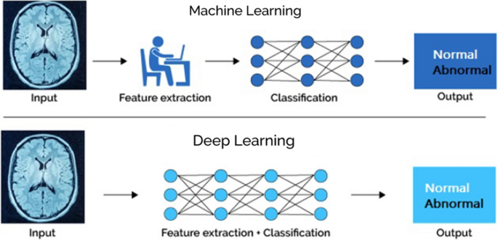
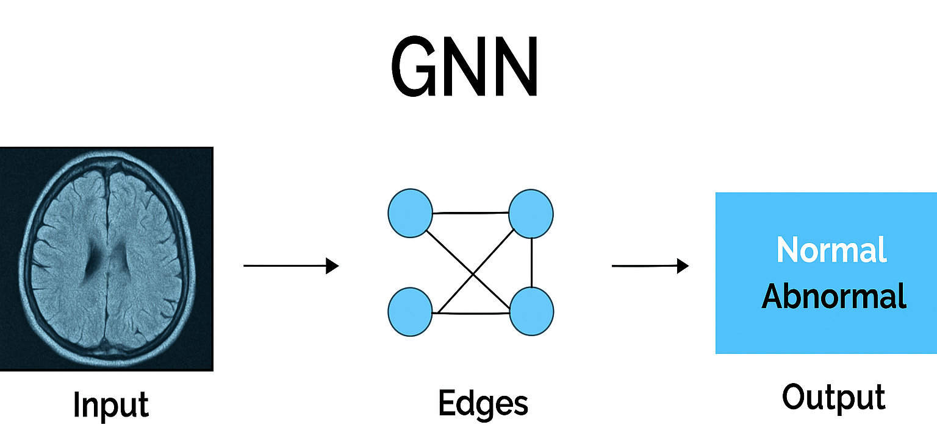
Models
Classical ML, DL Model
Graph Neural Networks
Graph Neural Networks
SVM,
Random Forest
Logistic Regression
MLP.
GCN
GAT
GNN embeddings (GCN)+ classical ML
GCN+MLP
Notes:
ML Models: SVM, Random Forest, Logistic Regression, MLP GNN Models: GCN, GAT Hybrid Models: GNN embeddings → classical ML (optional) Evaluation Metrics: Accuracy, F1-score, Precision, Recall Training: Early stopping, stratified splits

Slide 16
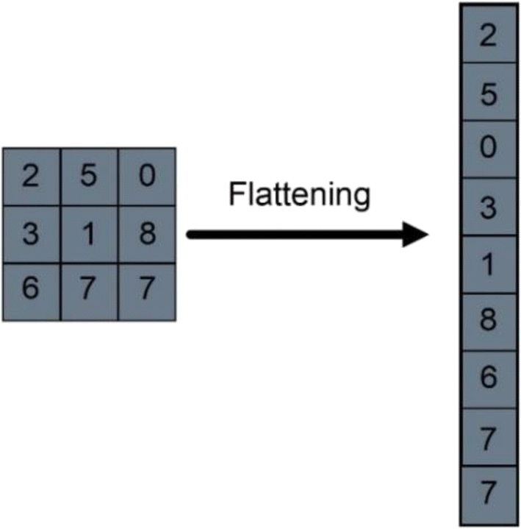
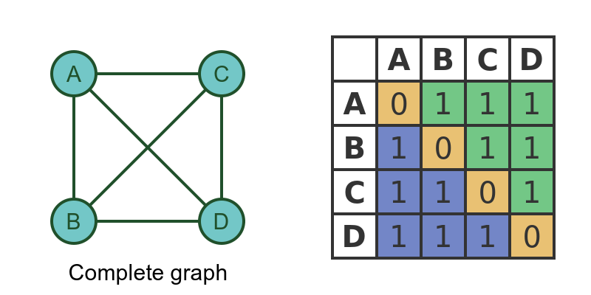
Model Architecture
Input Representations:
ML/DL: Flattened upper triangle of the correlation matrix.
GNN: Native graph structure (Node Features X + Adjacency Matrix A).
Hybrid: GCN+MLP, GCN+ML
Evaluation:
Stratified 5-Fold Cross-Validation using
Accuracy, F1-Score, AUC-ROC.
Notes:
Classical ML will use flattened matrices. DL models will take matrix-like inputs. And GNNs will directly use the graph structure. We’ll benchmark SVMs, Random Forests, CNNs, MLPs, GCNs, and GATs — using metrics like accuracy, F1-score, and AUC-ROC.”

Slide 17
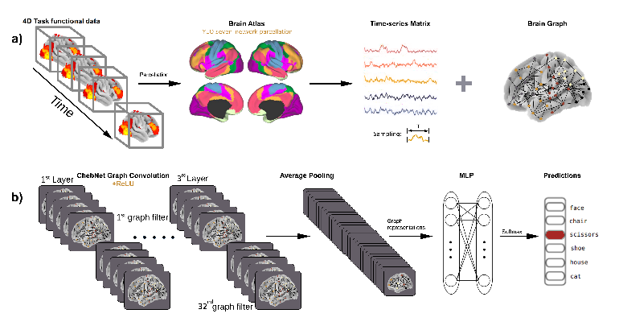
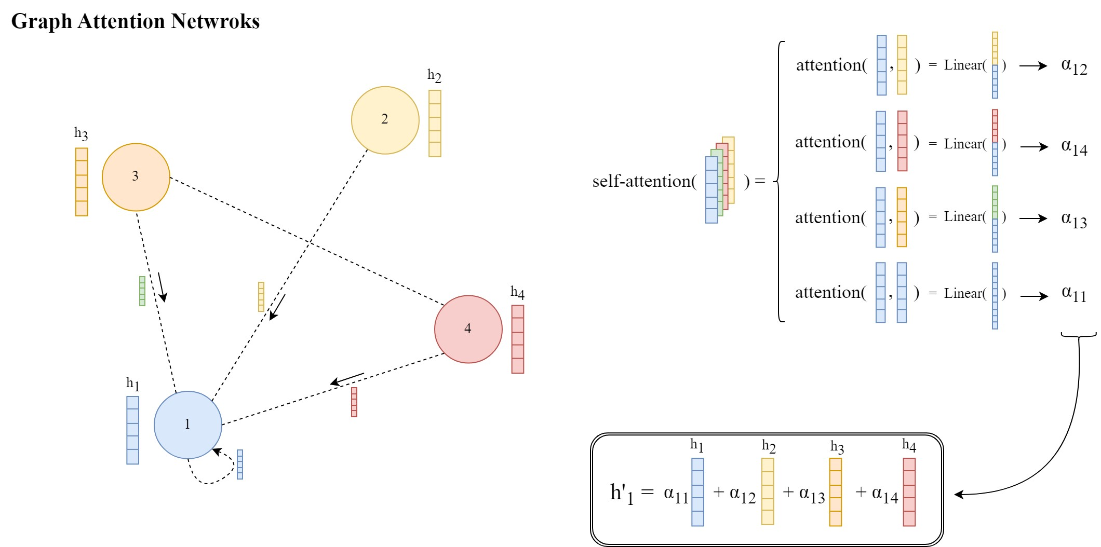
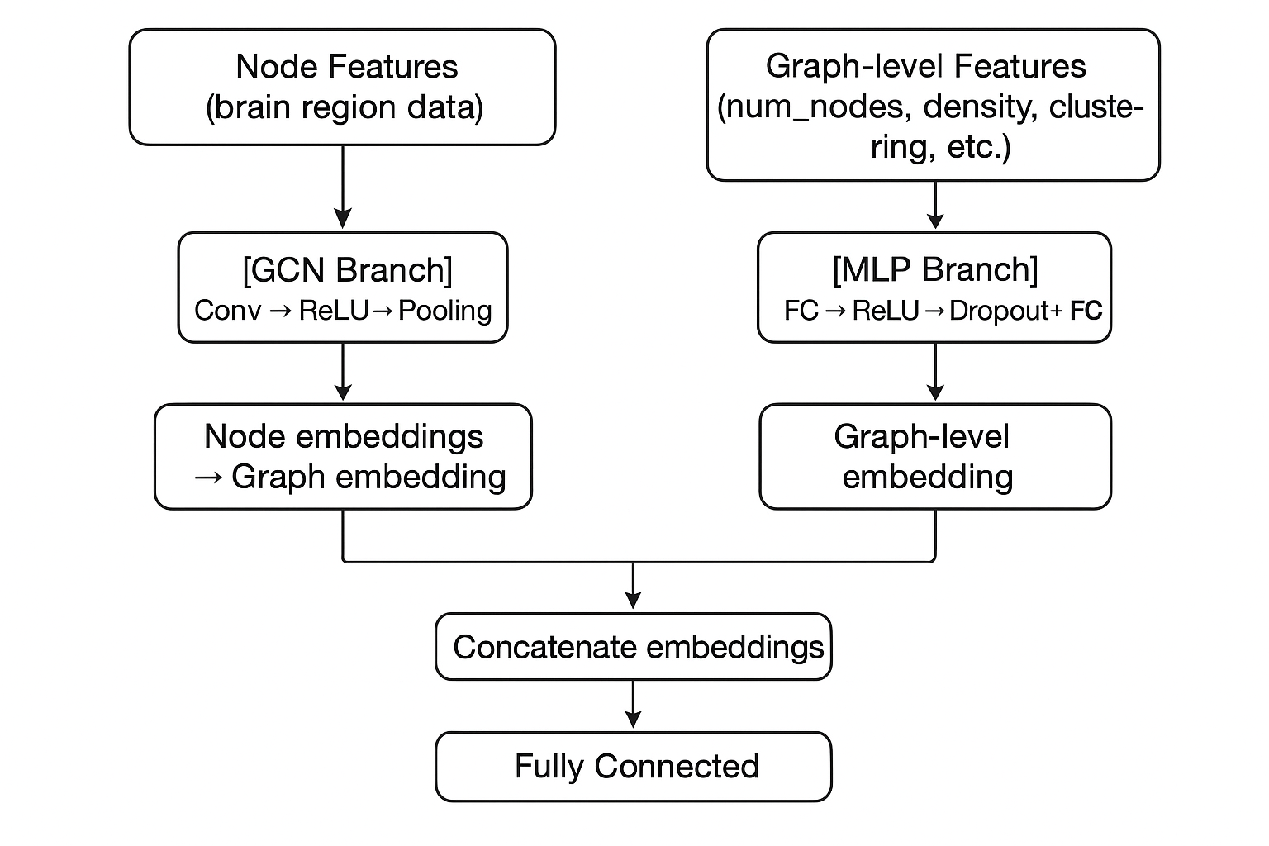

Slide 18
06
Results

Slide 19
Model Benchmark Results
Model Type | Model | Accuracy | Precision | Recall | F1-score
ML | SVM | 0.7933 | 0.6349 | 0.3500 | 0.4411
 | Random Forest | 0.7934 | 0.6381 | 0.3800 | 0.4675
 | Logistic Regression | 0.8054 | 0.6096 | 0.5500 | 0.5740
 | MLP | 0.8079 | 0.6133 | 0.5700 | 0.5816
GNN | GCN | 0.7738 | 0.7367 | 0.8172 | 0.7432
 | GAT | 0.6786 | 0.7367 | 0.8172 | 0.5321
Hybrid | GCN + ML | 0.7738 | 0.7367 | 0.8172 | 0.7432
 | GCN+MLP | 0.7381 | 0.5536 | 0.5919 | 0.5531
Notes:
Here are the final results. Classical ML models like MLP and logistic regression perform reasonably well. GNNs, particularly GCN, maintain high precision and recall, showing their ability to capture graph structure. Our hybrid model using GCN embeddings also shows strong performance, matching the GCN results.

Slide 20
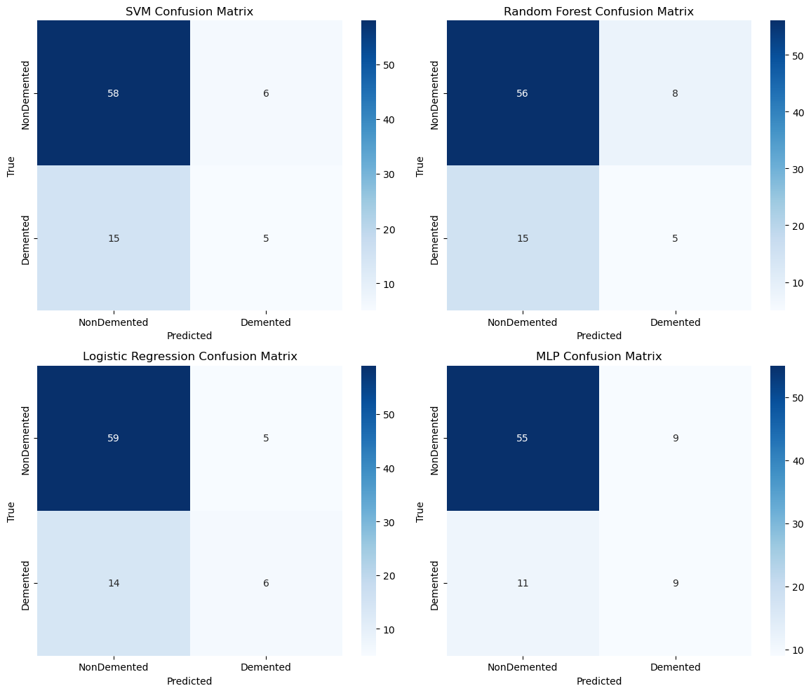
Results – Confusion Matrices ML
Notes:
Hybrid models use embeddings from GNNs (GCN) as input to ML classifiers.
Highlight GNN and hybrid performance to show the importance of preserving graph structure.
Optional: Add a mini flow diagram: Graph → GCN → Embeddings → ML Classifier → Prediction.

Slide 21
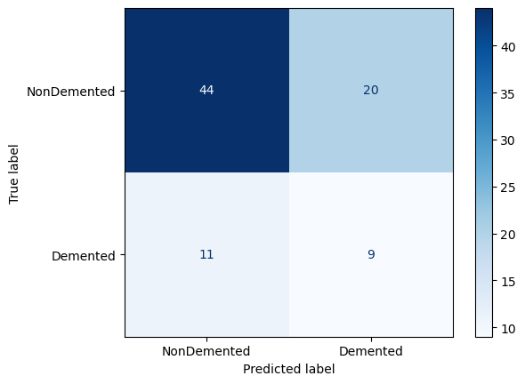
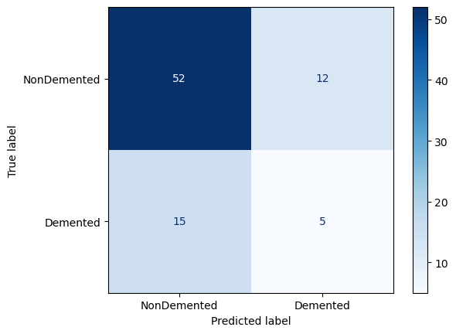
Results – Confusion Matrix GNN
GCN Model
GAT Model
Notes:
Hybrid models use embeddings from GNNs (GCN) as input to ML classifiers.
Highlight GNN and hybrid performance to show the importance of preserving graph structure.
Optional: Add a mini flow diagram: Graph → GCN → Embeddings → ML Classifier → Prediction.

Slide 22
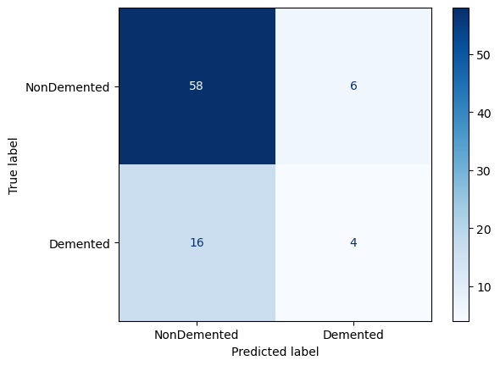
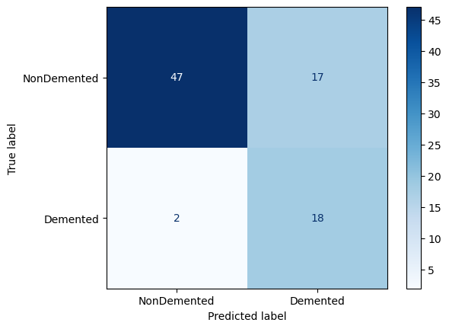
Results – Confusion Matrix Hybrid
GCN + MPL
GCN+ML
Notes:
Hybrid models use embeddings from GNNs (GCN) as input to ML classifiers.
Highlight GNN and hybrid performance to show the importance of preserving graph structure.
Optional: Add a mini flow diagram: Graph → GCN → Embeddings → ML Classifier → Prediction.

Slide 23
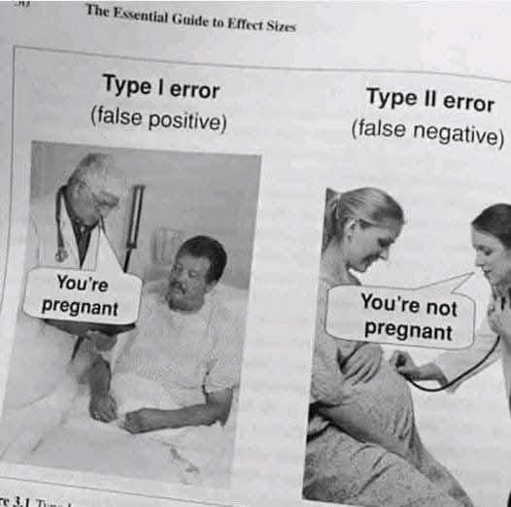
Means?

Slide 24
Results – Key Observations
GCN outperforms GAT among GNNs.
ML models are competitive in accuracy but do not capture graph topology.
Hybrid models show potential for embedding-based anomaly detection.
Confusion matrix analysis reveals strengths and weaknesses per class.
Notes:
Hybrid models use embeddings from GNNs (GCN) as input to ML classifiers.
Highlight GNN and hybrid performance to show the importance of preserving graph structure.
Optional: Add a mini flow diagram: Graph → GCN → Embeddings → ML Classifier → Prediction.

Slide 25

Results – Limitation!
Limited Dataset and Highly Unbalanced!
Notes:
Hybrid models use embeddings from GNNs (GCN) as input to ML classifiers.
Highlight GNN and hybrid performance to show the importance of preserving graph structure.
Optional: Add a mini flow diagram: Graph → GCN → Embeddings → ML Classifier → Prediction.

Slide 26
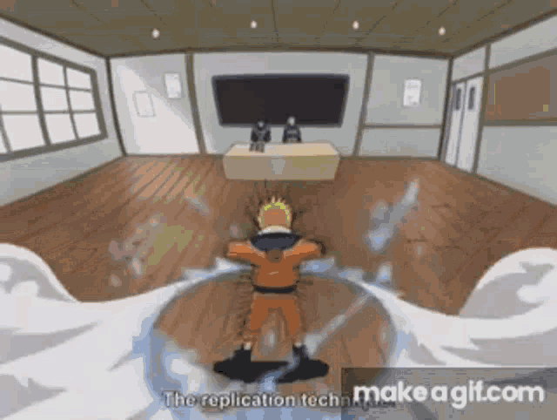

Results – Further Scopes
Do Proper Data
Augmentation
Avoid improper Data
Augmentation
Notes:
Hybrid models use embeddings from GNNs (GCN) as input to ML classifiers.
Highlight GNN and hybrid performance to show the importance of preserving graph structure.
Optional: Add a mini flow diagram: Graph → GCN → Embeddings → ML Classifier → Prediction.

Slide 27


Results – Further Scopes
Fast Learning
Slow learning
Notes:
Hybrid models use embeddings from GNNs (GCN) as input to ML classifiers.
Highlight GNN and hybrid performance to show the importance of preserving graph structure.
Optional: Add a mini flow diagram: Graph → GCN → Embeddings → ML Classifier → Prediction.

Slide 28
07
Main Contribution

Slide 29
Main Contribution
We have developed graph-based pipeline for OASIS MRI dataset.
We then did Systematic benchmark of ML, DL, and GNN.
Showed that GNNs preserve graph structure for better prediction.
We Proposed two Hybrid models that performs better than only GNN or ML or DL based basicArchitecture.
Dataset & code are reproducible for future research.
Notes:
"The main contribution of this study is the direct comparison of ML, DL, GNN, and hybrid approaches on the same dataset. We demonstrated that GNNs preserve topological information, leading to better predictive performance, and hybrid models provide a practical way to use GNN embeddings with classical ML."

Slide 30
08
Conclusion

Slide 31
Conclusion
Graph representation + GNN is crucial for brain disorder classification.
Classical ML still performs well on enriched features.
Hybrid approaches promising for real-time applications.
Future work:
Cross-dataset generalization &
Explainable GNN (GNNExplainer) → identify salient brain sub-networks
Notes:
"In conclusion, GNNs outperform traditional DL and ML models due to their ability to leverage graph structure. Hybrid models provide a flexible pipeline, and preserving brain graph topology is critical. Future work will explore robustness across datasets and interpretability to identify potential biomarkers."

Slide 32
Resources Used
Data:
OASIS-1 etc.
Software:
Python, PyTorch, PyTorch Geometric, scikit-learn, Nilearn
Jupyter Notebook, Anaconda
Hardware:
NVIDIA RTX 3060 GPU
AMD Ryzen 7 5700X CPU
32GB RAM
Reproducibility & Team Communication Purposes:
All code will be made publicly available on GitHub.
Notes:
The project will use open datasets, Python, PyTorch, and scikit-learn, with NVIDIA RTX GPUs. All code will be shared on GitHub to ensure reproducibility. Our timeline includes preprocessing and model development first, followed by benchmarking, robustness testing, and final analysis.

Slide 33
09
Reference

Slide 34
References
[1] Kim, H., Lee, B. S., Shin, W.-Y., & Lim, S. "Graph Anomaly Detection with Graph Neural Networks: Current Status and Challenges," arXiv:2209.14930, Sep. 2022.
[2] Pang, G., Shen, C., Cao, L., & van den Hengel, A. "Deep Learning for Anomaly Detection: A Review," ACM Computing Surveys, vol. 54, no. 2, Mar. 2021.
[3] Gao, Y., Zhu, Q., Shi, X., & Jin, H. "A Transformer-Based Spatio-Temporal Graph Neural Network for Anomaly Detection on Dynamic Graphs," in Big Data, Springer, Jan. 2025. (Relevant for advanced spatio-temporal modeling).
[4] Schummer, P., del Rio, A., Serrano, J., et al. "Machine Learning-Based Network Anomaly Detection: Design, Implementation, and Evaluation," AI, vol. 5, no. 4, 2024.
[5] Sattar, S., Khan, S., Khan, M.I., et al. "Anomaly Detection in Encrypted Network Traffic Using Self-Supervised Learning," Scientific Reports, vol. 15, 2025. (Relevant for hybrid/unsupervised approaches).
[6] T. N. Kipf and M. Welling, "Semi-Supervised Classification with Graph Convolutional Networks," in International Conference on Learning Representations (ICLR), 2017. This is the foundational paper for Graph Convolutional Networks (GCNs), the architecture upon which many modern neuroimaging GNNs are built. It is essential for justifying the choice of GCN as a baseline model.
[7] X. Li, Y. Zhou, N. Dvornek, M. Zhang, S. Gao, J. Zhuang, D. Scheinost, L. H. Staib, P. Ventola, and J. S. Duncan, "Pooling Regularized Graph Neural Network for fMRI Biomarker Analysis," in Medical Image Computing and Computer Assisted Intervention (MICCAI), 2020, pp. 625–635. This paper directly applies a regularized GNN to fMRI data for autism biomarker discovery, providing a strong, directly relevant methodological precedent for your work.
[12] H. Peng, S. Li, Y. Jiang, H. Lu, Y. Fang, K. Li, and S. Yu, "Graph Neural Networks for Brain Graph Analysis: A Survey," ACM Computing Surveys, 2023. This recent survey paper is an excellent resource for your introduction and literature review, as it comprehensively covers the state-of-the-art in applying GNNs to brain graphs, including various architectures and tasks.
Notes:
Our references include foundational works in GNNs, recent surveys, and cutting-edge papers applying these methods to brain connectomes.
To conclude: this project doesn’t just benchmark algorithms — it takes us closer to AI-powered, early, and reliable diagnosis of neurological disorders. Thank you.

Slide 35
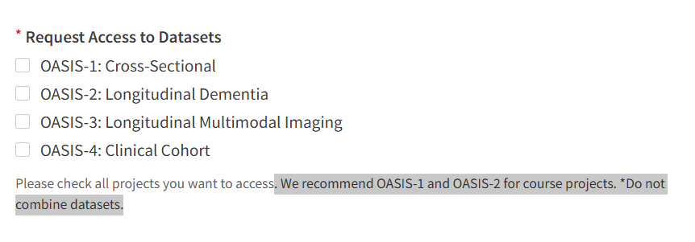
Dataset Reference
https://sites.wustl.edu/oasisbrains/home/oasis-1/
Notes:
Our references include foundational works in GNNs, recent surveys, and cutting-edge papers applying these methods to brain connectomes.
To conclude: this project doesn’t just benchmark algorithms — it takes us closer to AI-powered, early, and reliable diagnosis of neurological disorders. Thank you.

Slide 36
Thank You

